Slide 1

Talk Together

Slide 2
How to Play
Do rock paper scissors. The winner rolls the die.
The other student should say “What will you do for the Earth?”
The winner should answer “ I will ____________.” and color the coin.
Don’t do rock paper scissors again. The loser goes next.
If you have 3 coins in a picture, you would get 1 point. The person who has more points will be the winner.

Slide 3
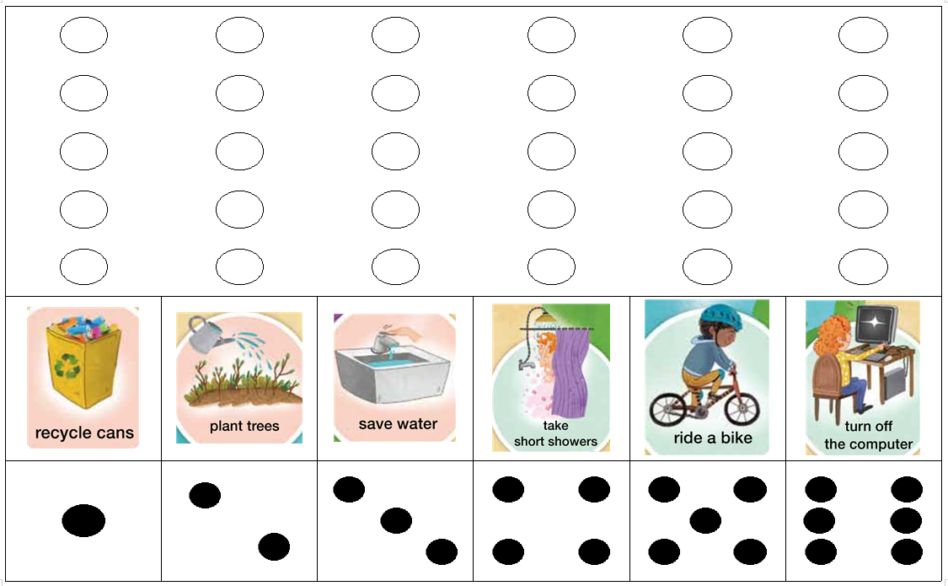
Pick up trash
Save energy
Save water
Turn off the lights
Use less plastic
Ride a bike

Slide 4
What will you do for the Earth?
I will…
save energy take short showers
save water turn off the light
take a walk use less plastic
plant trees ride a bike
use a cup put trash in the trash bin
recycle bottles turn off the T.V.

